Slide 1
Kubernetes
Made by:
Nagy Bence

Slide 2
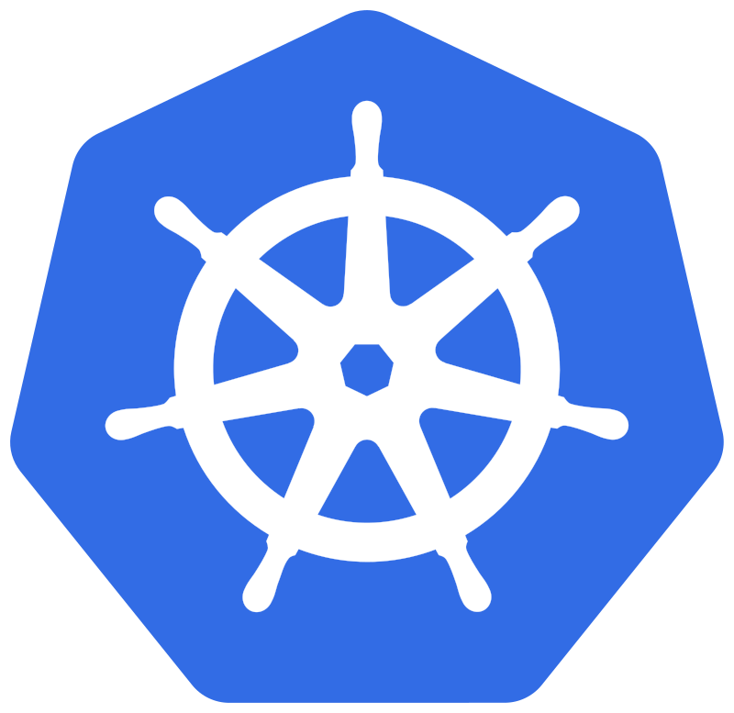
What is kubernetes ?
Kubernetes is an open source container orchestration platform that was originally developed by Google and later became a project supported by the Cloud Native Computing Foundation (CNCF). Kubernetes is designed to help developers and operators efficiently manage and scale containers (such as Docker containers) for large applications and services.

Slide 3
You should use kubernetes if your company:
Develops applications as microservices.
Develops applications as native cloud applications.
Deploys microservices using containers.
Updates containers many times.
Requires centralized container-networking and
storage management.

Slide 4
Main functions and features
Container management: Kubernetes allows easy and
efficient management of containers
(such as Docker containers), including starting, stopping,
and updating containers.
Open source: Kubernetes is an open source project,
so it is freely available
Scheduling: Kubernetes is responsible for scheduling
pods based on available resources, so you can run
them on the most suitable machines.

Slide 5
Main functions and features
State management: Allows you to manage the state of
applications and services, making it easy to configure
and update them.
Scalability: Ability to add or remove system components,
to form large clusters.
Monitoring and Self-healing: Kubernetes monitors
Applications and pods and automatically recovers
them when a failure occurs.

Slide 6
Main functions and features
Shared networking and storage: Kubernetes
provides shared networking and storage solutions.
Load Balancing: Kubernetes has built-in load
balancing mechanisms that allow incoming
traffic to be distributed evenly across pods.

Slide 7
Who is it recommended for?
robust
robust
For those who care that:
everything can be customized within the system
to automate the operation
the system should be robust
run scheduled tasks
you need built-in monitoring

Slide 8
Thanks for the attention!

